Slide 1
AccessMiner:Using system-centric Models for Malware Detection
Andrea Lanzi / Institute Eurecom
Davide Balzarotti / Institute Eurecom
Christopher Kruegel / University of California
Mihai Christodorescu / IBM T.J. Watson Research
Engin Kirda / Institute Eurecom

Slide 2
Outline
Introduction
Data collection
N-gram models & Detection Results
Access activity models & Detection Results
Conclusion

Slide 3
Outline
Introduction
Data collection
N-gram models & Detection Results
Access activity models & Detection Results
Conclusion

Slide 4
Introduction
The signature-based detection could be evaded with Code obfuscation and polymorphism
To address the limitations of signature-based detection , behavior-based detection was introduced as a novel approach.
Notes:
Behavior-based do not examine the static content but rather dynamic actions
→即使在語法改變、語意不變的情況下也可以偵測

Slide 5
Related work
The most popular way to characterize the behavior of programs is based on some kind of analysis of the system calls (or Win32 API functions) that a program invokes:
Looking at sequences of system calls
System call patterns based on data flow dependencies.
Yet other techniques look at individual system calls, but take into account argument information.

Slide 6
The limitations in related work
The presented results reveals that most experiments are performed on a relatively small scale.
The reported number of false positive might be underestimated.
These benign programs are exercised in often using synthetic inputs or launching simple test cases.
It’s not clear whether the observed system call traces are representative for the diverse set of applications that is used by actual users.

Slide 7
Program-centric V.S. System-centric
Program-centric techniques aim to model the execution of individual programs:
these models lack context that captures how benign programs interact with their environment.
Program-centric detector often take a narrow view on execution history:
E.g., a sliding window of k consecutive system calls
Detectors raise an alert whenever something “new” is encountered. (this leads to high false positive)

Slide 8
We assume a sliding windows k=2
Read A | Write A | Execute A | Write B | Execute B
New behaviors!!
Read A | Write A | Write B | Execute A | Execute B
Raise alert !!

Slide 9
Outline
Introduction
Data collection
N-gram models & Detection Results
Access activity models & Detection Results
Conclusion

Slide 10
Raw data collection
Kernel collector
The main goal is to collect system call and process in formation across entire system.
Hooking the system service dispatch table (SSDT) to intercept and log system call information.
Each log entry is a tuple :
<timestamp , program , pid , ppid , system call, arguments , results>
79 different system calls in 5 categories:
File: 25
Registries: 23
process and thread: 25
Network: 1
Memory: 5

Slide 11
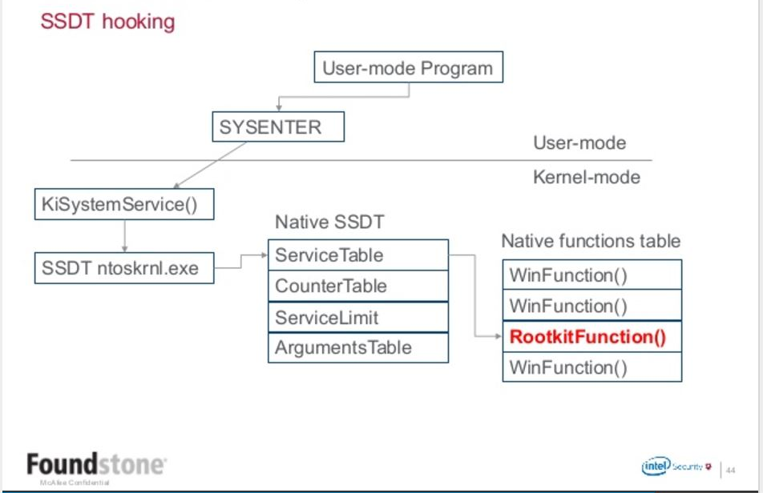
Reference (slide p44):
https://www.slideshare.net/ThomasRoccia/kernel-debugpresentation

Slide 12
Raw data collection
Log anonymizer
Replacing part or whole of a sensitive argument value with a randomly-generated value.
Sensitive arguments:
Non-system path (e.g., path under C:\Documents and Settings)
All registry key below the user-root registry key(HKEY_LOCAL_MACHINE)
IP address
Notes:
The repeated value will be replaced with the same value

Slide 13
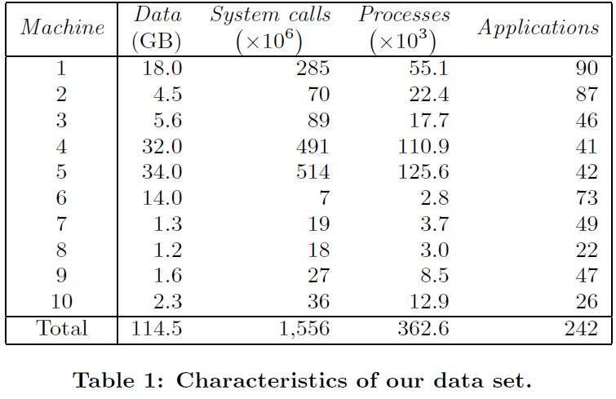
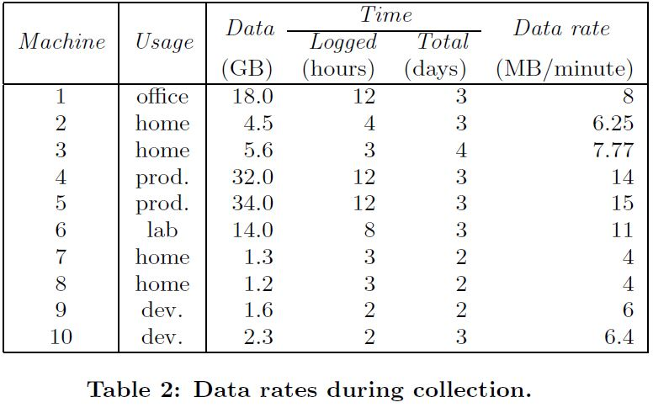
Experimental Data Set
Notes:
Target OS: Windows XP
More than 1.5 billion system calls invoked by 242 different applications.
All of the 242 applications has been executed more than 362000 times.

Slide 14
Outline
Introduction
Data collection
N-gram models & Detection Results
Access activity models & Detection Results
Conclusion

Slide 15
N-gram models
When this sequence contains the k instances of n-grams that are considered malicious, the process is identified as malware.
Ran 10 experiments , one for each of ten machines in our data set:
Use the system call traces from nine machines and a random selection of two-thirds of the malware set (10838 from Anubis) to train a model.
The last third of the malware samples are used to determine true positive
The system call from tenth machine are used to determine false positive

Slide 16
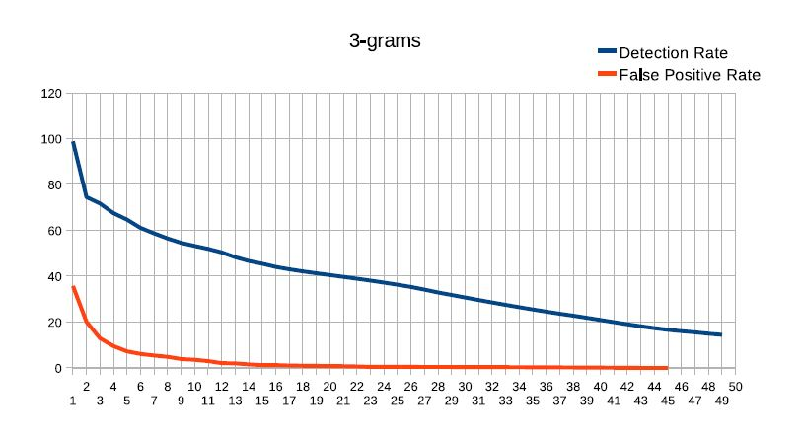
Detection Results

Slide 17
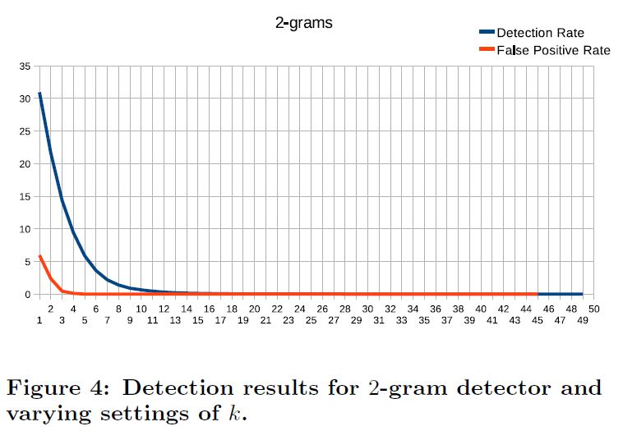
Detection Results

Slide 18
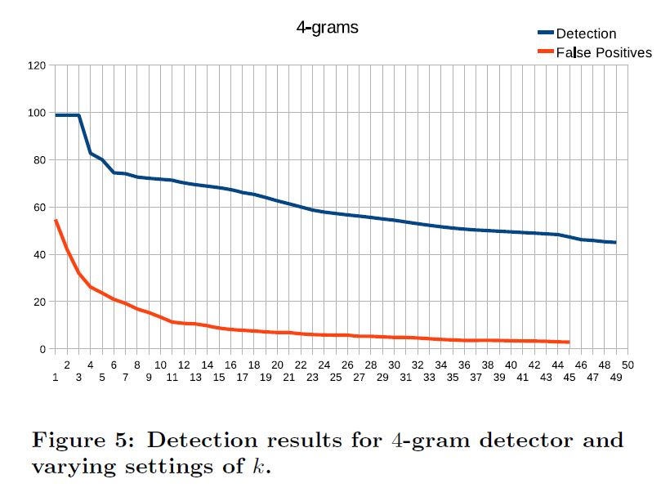
Detection Results

Slide 19
Outline
Introduction
Data collection
N-gram models & Detection Results
Access activity models & Detection Results
Conclusion

Slide 20
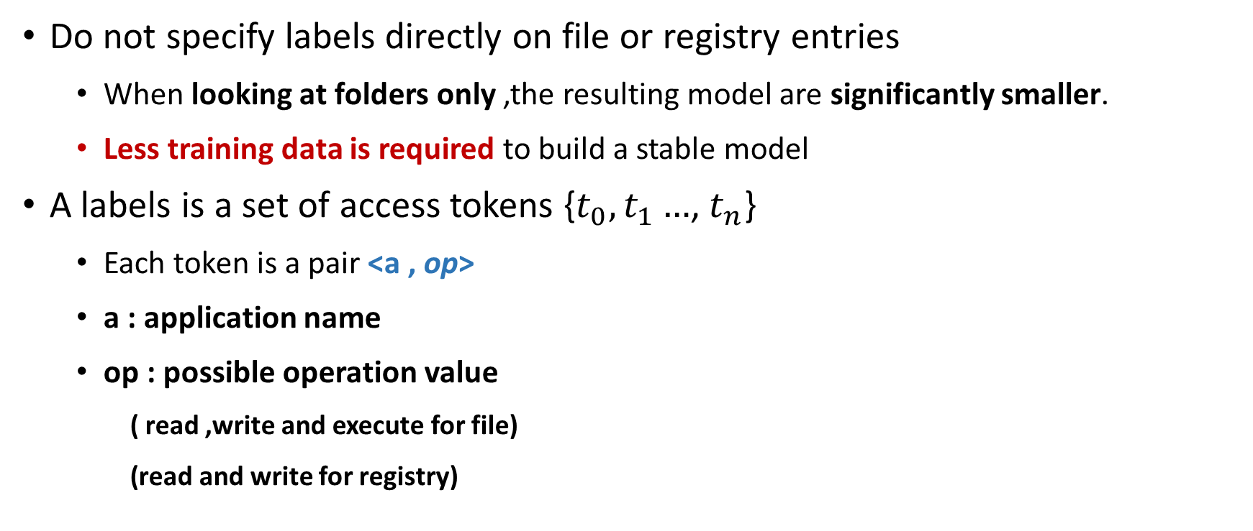
Create Access Activity models
Do not specify labels directly on file or registry entries
When looking at folders only ,the resulting model are significantly smaller.
Less training data is required to build a stable model
A labels is a set of access tokens {$t_{0},t_{1}…$, $t_{n}$}
Each token is a pair <a , op>
a : application name
op : possible operation value
( read ,write and execute for file)
(read and write for registry)

Slide 21
Data pre-processing
Remove all applications that read or execute files in more than 10 % of the directories.
Total 15 applications found
9 windows core service , 2 desktop indexing application and 6 AV programs
Identify application that start process with different name
Merging processes that have different names.
14 application found(e.g., MS office , Skype and RealPlayer)

Slide 22
Model generation
The generation step perform a post-order traversal of both virtual file system tree and virtual registry tree.
Check the children of the current node to determine whether access token can be propagated upward in the tree.
Ensure that whenever an application access a previously unseen folder in a container ,this should be allowed.

Slide 23
Model generation
Find all access tokens that share the same operation op.
All tokens share the same application name → keep a single copy
The application names are different → replace the tokens with a single token,<*,op>
Add access tokens that were likely missed because the training data is not complete.
For each access token that is related to a write operation, authors check whether there exists a corresponding read token.

Slide 24
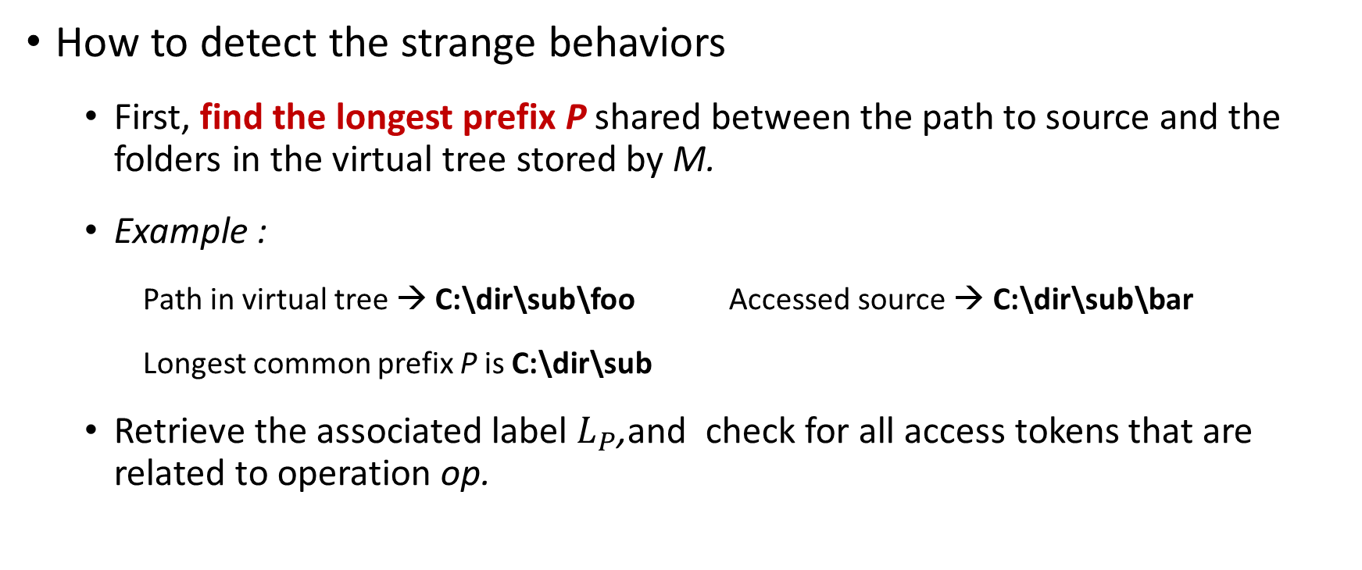
Model enforcement & Detection(1/2)
How to detect the strange behaviors
First, find the longest prefix P shared between the path to source and the folders in the virtual tree stored by M.
Example :
Path in virtual tree → C:\dir\sub\foo Accessed source → C:\dir\sub\bar
Longest common prefix P is C:\dir\sub
Retrieve the associated label $L_{P}$,and check for all access tokens that are related to operation op.

Slide 25
Model enforcement & Detection(2/2)
How to detect the strange behaviors
When no token is found, the model raise alerts
When a token is found, its first component(application name) is compared with proc.
If name matched or the first component is *,the access succeed.
Otherwise, model raise an alert.

Slide 26
Detection Models
File system access activity model
Registry access activity model
Full access activity model

Slide 27
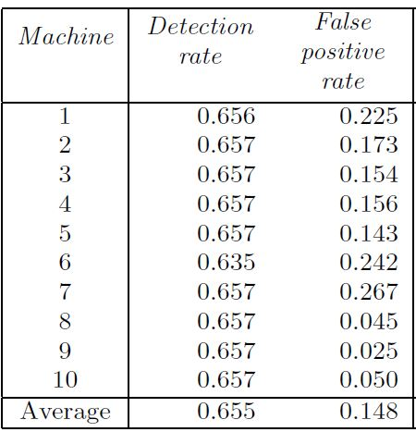
File system access activity model - original
Using original model to check read , write and execute access
Detection rate: almost 66%
False positive: almost 15%
Investigating the false negative
Many samples did not get far in their execution but quickly exited or crashed.
Most of these sample never wrote to file system or registry and didn’t open network connections.

Slide 28
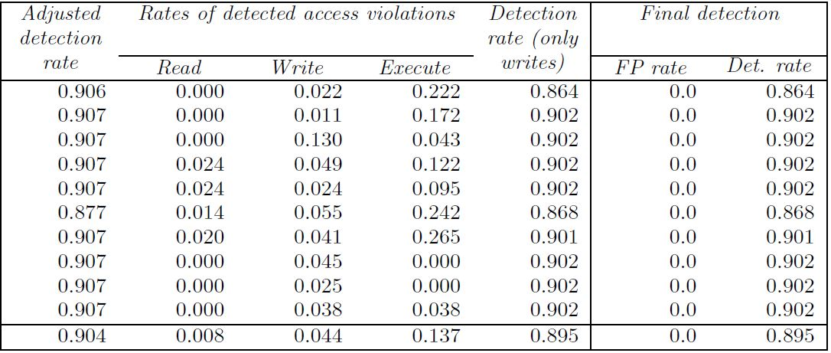
File system access activity model - adjusted
Remove samples that never perform write operation or network connections from malware data set
This decrease malware data set to 7847
Improve the detection rate to more than 90%

Slide 29
File system access activity model – write only
Authors also found that “write” are only marginally important for detection.
For the next experiment, they decided to use only the access tokens that refer to write operations.
With this approach ,the false positive is identical to write violation.

Slide 30
File system access activity model – write only
Grant the model write access to C:\
The detection capability of model basically remain unchanged.
No more false positive

Slide 31
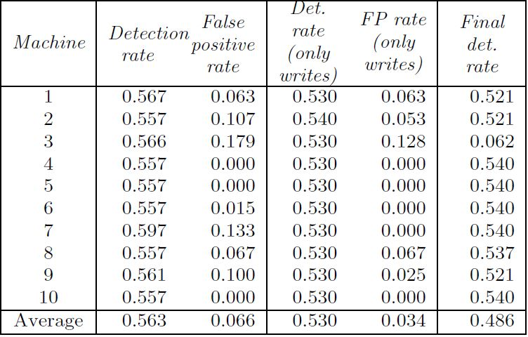
Registry access activity model
Original Registry access activity
Both of the Detection rate and False positive are lower than the file system model.
Examine both when considering only write operation
False positive rate decreased
Model still achieves a detection rate of over 48%

Slide 32
Registry access activity model
Considering the significantly larger size of the registry models compared to the ones for the file system
Registry models : 3000 labels
File system model : about 100 labels
We expect that a larger training set would be required to effectively capture legitimate writes to the Software\Microsoft sub-tree.

Slide 33
Full access activity model
Combine improved file system and registry models
Average detection rate from 89.5% to 91 % (10 folds)
With no false positive

Slide 34
Outline
Introduction
Data collection
N-gram models & Detection Results
Access activity models & Detection Results
Conclusion

Slide 35
Conclusion
System-centric approach is more suitable for distinguishing between benign and malicious activity.
The current detection model couldn’t cover all types of the malicious activities.
The malware that ignore other applications and the OS
(e.g., the malware does not attempt to hide its presence or to gain control of the OS)
The malware that carry out operation only over the network.
The malware perform malicious activities that similar to the benign activities.

